Slide 1
 |  |  | NEWSLETTER - SEPTEMBER 2023
NFN Fall symposium
On the 13th of October the NFN Fall symposium will take place. Organized by the Dutch Federation of Nephrology, it is one of the premier opportunities for kidney-specific PhD students in the Netherlands to share their research.
Already over 40 abstracts have been submitted and prizes for the best ones will be given out. Deadline for submission has unfortunately passed but it is definitely worthwhile to attend! Please check the website of the NFN/ our LinkedIn.
PLAN day Leiden
We are very happy to announce that we have started preparations for the next on-site PLAN day! On December 15th, Leiden will host the second PLAN day of 2023. We will inform you as soon as we know more details! Stay tuned for an interesting day of research and networking! Please check our LinkedIn or mail: m.van_schaik@lumc.nl
Kidney Week 2023
Kidney Week 2023 in Philadelphia, PA Nov 1-5
The conference will be both virtual and live.
The American society for Nephrology organizes the largest annual Nephrology Congress in the world, welcoming thousands of attendees. The congress programme is now online and includes the latest innovations as well as the newest information in the clinical and scientific field of nephrology. Of course, PLAN will be present to organize drinks for the physical attendees, more information will follow soon!

Slide 2
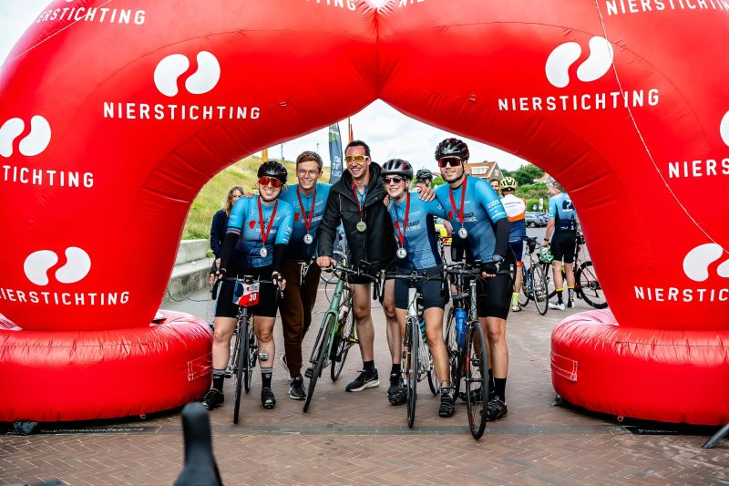
 |  |  | NEWSLETTER - SEPTEMBER 2023
Coast to Coast challenge 2023
On the first of July 2023 the first ever Coast to Coast challenge by the Dutch Kidney Foundation took place. Over 100 participants cycled 500 kilometers for 24 hours from Zoutkamp in Groningen to Zoutlande in Zeeland.
To say that it was a absolute success is an understatement, over 124.000 € were raised to fund kidney research in the Netherlands!
We’re very proud to say that as PLAN we were able to contribute to this amazing event. Daan Kremer (former PLAN Board Member without any cycling experience), Niek Hessels, Crissy Rudolphy, Pien Rawee, Robin Vernooij and Adrian P. represented us.
Next year the CTC will take place again, more info to follow soon!
We would also like to thank our sponsor GeriCall for supporting us financially.

Slide 3
 |  |  | NEWSLETTER - SEPTEMBER 2023
DATES & DEADLINES Dialyse symposium - 29/09/2023 Bonte Wever, Assen NFN fall meeting - 13/10/2023 Accelerator Utrecht [abstract submission closed] PLAN day - 15/12/2023 Leiden LUMC Kidney Week - 1-5/11/2023 Philadelphia, Pennsylvania USA 34e Workshop Nefrologie - 13-14/12/2023 Papendal, Arnhem
Introducing our newest board member Jip Jonker, MD PhD-candidate Greetings, I am Jip Jonker, a PhD candidate at the University of Groningen since June 2023. My primary research objective revolves around quantifying immunosuppression in transplant recipients, with the aim of enhancing the personalization of immunosuppressive medication. As a Plan board member, my responsibilities include conducting interviews with fellow researchers.
More info about PLAN, or become an NFN member Find us on LinkedIn If you would like to receive the PLAN newsletter with information about upcoming events, or if you have suggestions or interesting events that should be listed in the upcoming newsletter, please contact us via nefro.plan@gmail.com. If you no longer want to receive this newsletter, you can contact us via nefro.plan@gmail.com and you will be removed from the mailinglist.
Are you an NFN member yet?
PLAN’s activities are generously supported by its parent organization, the Dutch Federation of Nephrology (NFN).For only €20 per year you can become an NFN member.
We encourage you to register on nefro.nl, so we can keep organizing our free events. You can always email us @ nefro.plan@gmail.com.
Visit PLAN on LinkedIn!
To stay informed on all PLAN activities, check our LinkedIn Page !
We also publish other interesting events and news to be sure you never miss anything.
Be sure to register in time!

